Slide 1

Customer Segmentation and Market Basket Analysis
Data Exploration, Clustering, Association Rule Mining
Team Members:
Abuzer Bharuchi
Krish Patel
Ektedar Ahmed
Harshita Pahadia

Slide 2
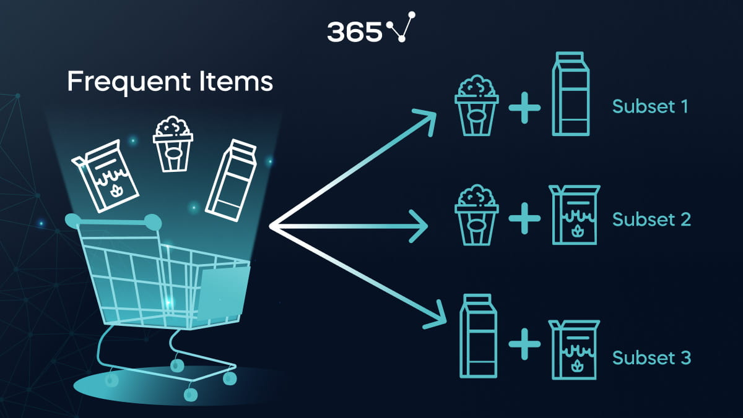
Objective
Goal:
Segment customers for personalized marketing strategies
Apply Market Basket Analysis for product recommendations
Approach:
Perform data preprocessing and segmentation using clustering
Apply Apriori algorithm for association rule mining on transaction data
Goal |

Slide 3

Data Overview
Dataset: Online Retail Dataset
Main Columns:
Customer ID, Country, Description, Quantity, Unit Price, Invoice Date
Data Cleaning:
Remove missing values, zero or negative prices, and invalid stock codes such as POST, M, D
Filter: Focus on German customers

Slide 4
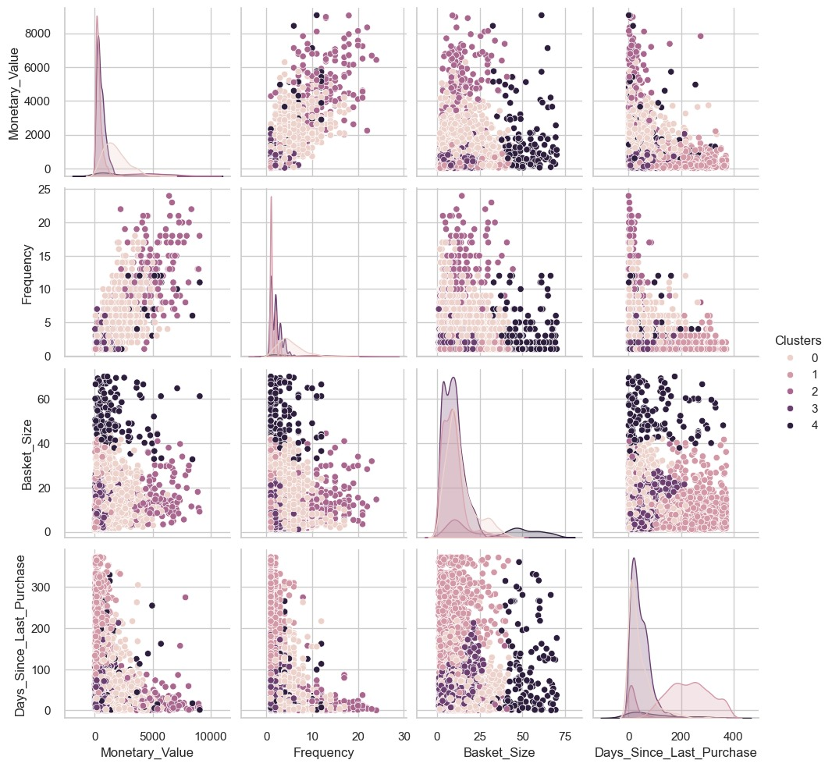
Customer Segmentation (Data Preprocessing)
Attributes Created:
Recency: Days since the last purchase
Frequency: Total purchases per customer
Monetary Value: Total revenue per customer
Basket Size: Average quantity per purchase
Number of Returns: Total negative
transactions indicating
returns
Purpose:
Prepare data for clustering analysis

Slide 5
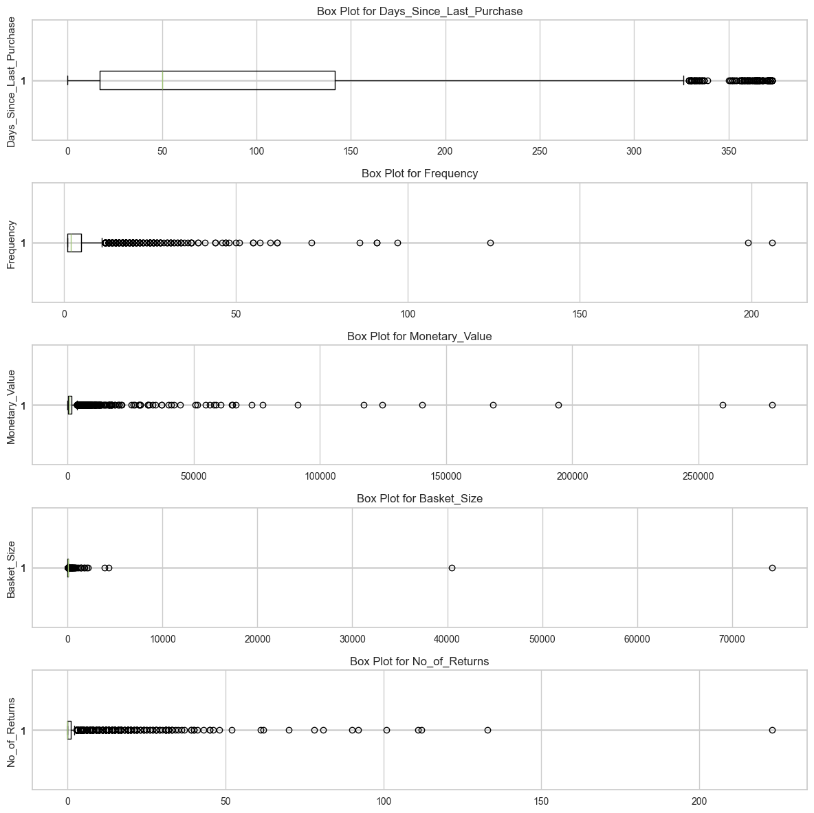
Data Distributions
Box plot and KDE Plots:
Visualize the distribution of Frequency, Monetary Value, Basket Size, and other features
Insight:
Identify skewness, peaks, and outliers to understand customer behavior

Slide 6
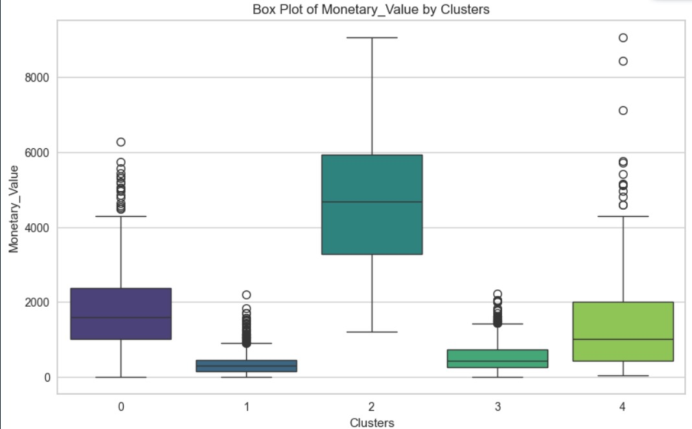
Handling Outliers
Outlier Detection Method:
Interquartile Range (IQR) for bounds on each feature
Box Plots:
Visualize feature distributions after outlier handling
Outcome:
Smoothed data ready for clustering

Slide 7
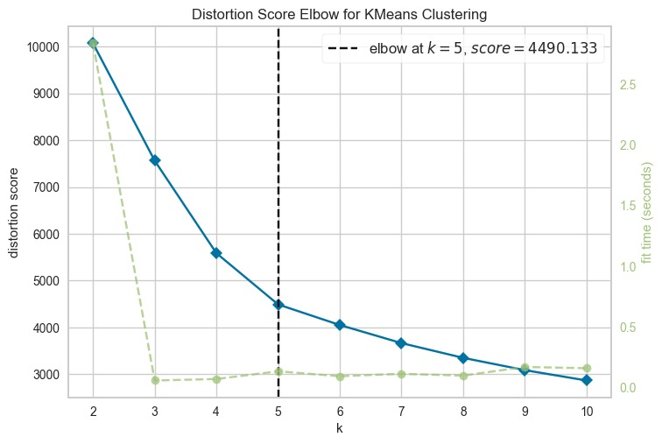
Clustering Analysis (PCA and KMeans)
PCA: Reduce dimensionality while retaining variance
Elbow Method: Determine optimal number of clusters
Agglomerative Clustering: Segment customers into meaningful clusters
Visualization: 3D scatter plot of clusters in PCA space

Slide 8
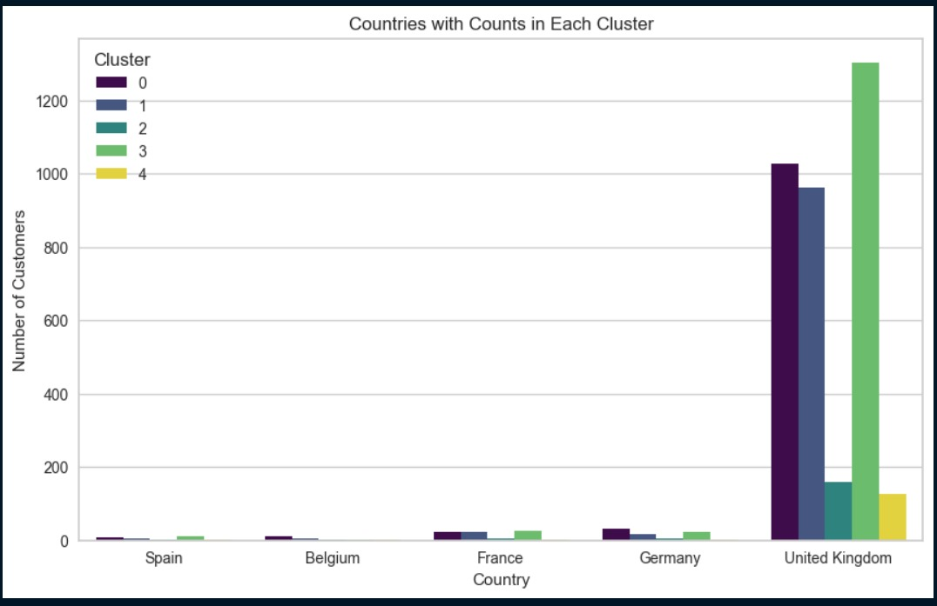
Examine key features such as Frequency, Monetary Value, and Days Since Last Purchase
Cluster Interpretation
Cluster profile:
Examine key features such as Frequency, Monetary Value, and Days Since Last Purchase
Cluster Distribution:
Plot clusters by country for comparison
Insight:
Each cluster represents a unique customer group, aiding targeted marketing

Slide 9
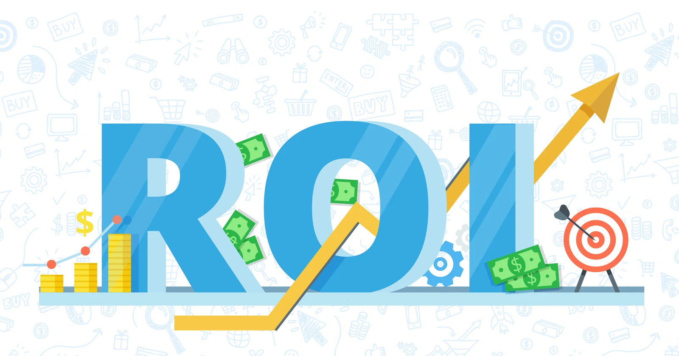
Market Basket Analysis (Apriori Algorithm)
Objective: Discover frequently bought itemsets
Key Steps:
Data Preparation: Create product
matrices by StockCode
Association Rules: Use Apriori for
rule mining
Threshold: Minimum support of one percent for frequent itemsets

Slide 10
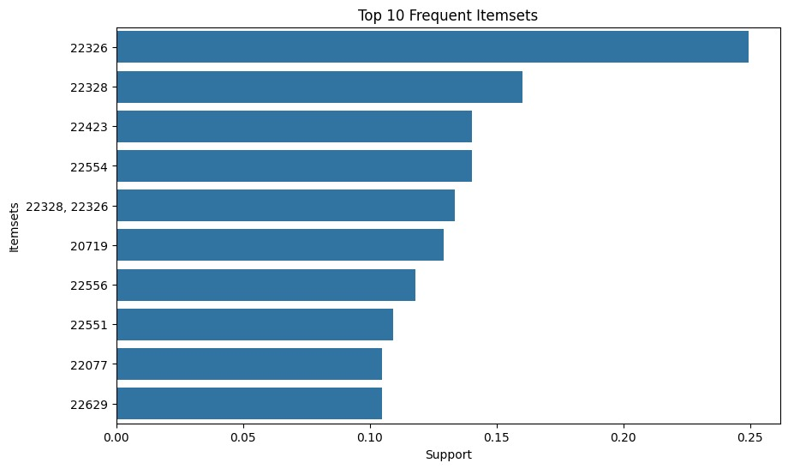
Frequent Itemsets and Association Rules
Visualization:
Top Itemsets: Bar plot of top 10 itemsets by support
Confidence vs Lift: Scatter plot to understand rule strength
Key Metrics:
Support, Confidence, Lift

Slide 11

Product Recommendation System:
System Overview:
Given a product, suggest complementary items
Functionality:
Identify high-lift association rules to recommend relevant products
Example: Input product ID generates top recommendations

Slide 12
CONCLUSION AND KEY TAKEAWAYS
Insights:
Segmentation reveals actionable customer clusters
Market Basket Analysis provides meaningful product associations
Future Enhancements:
Incorporate real-time recommendation updates
Experiment with different clustering and association algorithms for better accuracy

Slide 13
Thanks!
Presented by:
Abuzer Bharuchi(B23BB1028)
Krish Patel(B23ES1019)
Ektedar Ahmed(B23CH1017)
Harshita Pahadia(B23MT1020)

